Slide 1
Lending club case study

Slide 2
Business Understanding
A consumer finance company specialises in lending various types of loans to urban customers. When the company receives a loan application, the company has to make a decision for loan approval based on the applicant’s profile. Two types of risks are associated with the bank’s decision:
If the applicant is likely to repay the loan, then not approving the loan results in a loss of business to the company
If the applicant is not likely to repay the loan, i.e. he/she is likely to default, then approving the loan may lead to a financial loss for the company

Slide 3
Business Objective
This company is the largest online loan marketplace, facilitating personal loans, business loans, and financing of medical procedures. Borrowers can easily access lower interest rate loans through a fast online interface.
Like most other lending companies, lending loans to ‘risky’ applicants is the largest source of financial loss (called credit loss). Credit loss is the amount of money lost by the lender when the borrower refuses to pay or runs away with the money owed. In other words, borrowers who default cause the largest amount of loss to the lenders. In this case, the customers labelled as 'charged-off' are the 'defaulters'.
the company wants to understand the driving factors (or driver variables) behind loan default, i.e. the variables which are strong indicators of default.

Slide 4
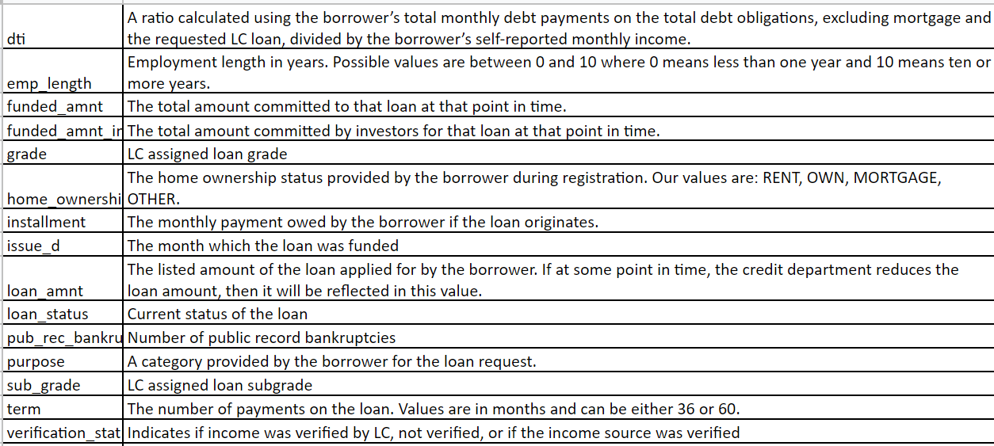
Data Snapshot

Slide 5
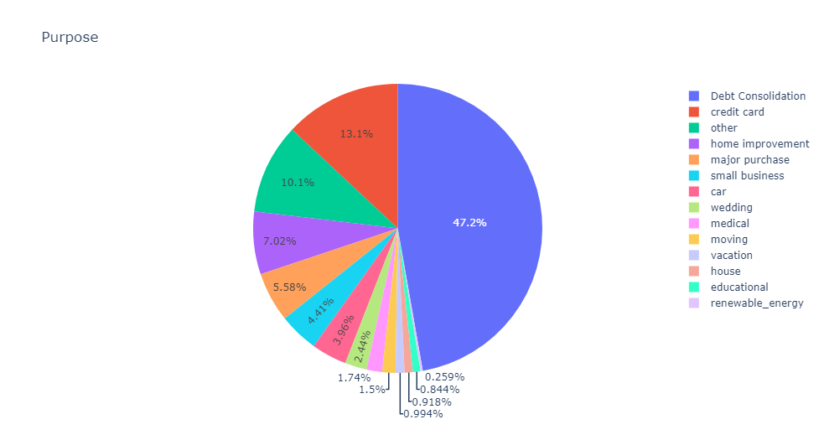
Top reasons for applying for a loan

Slide 6
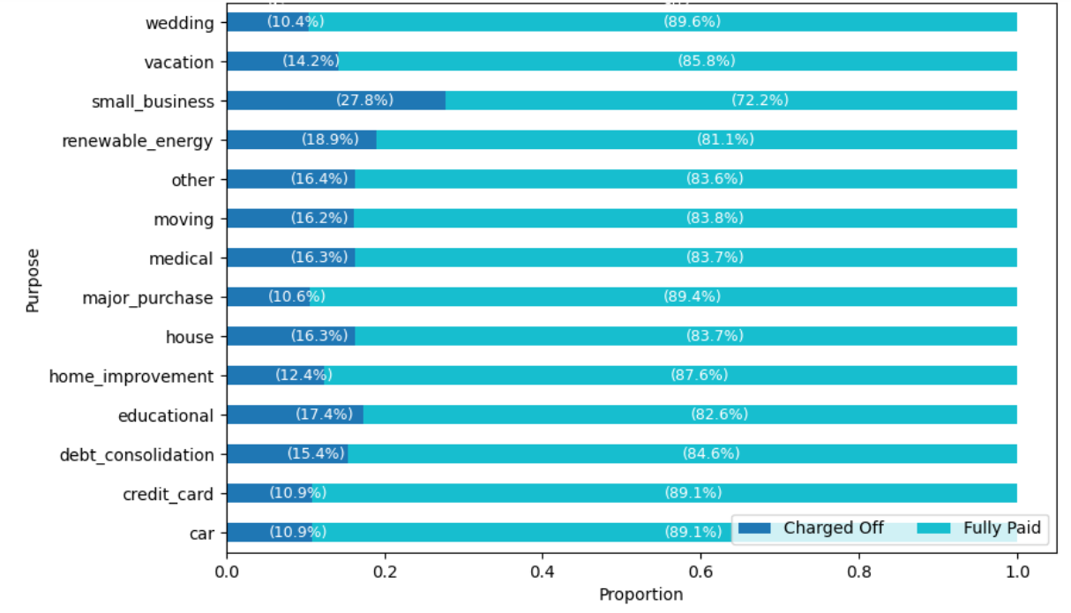
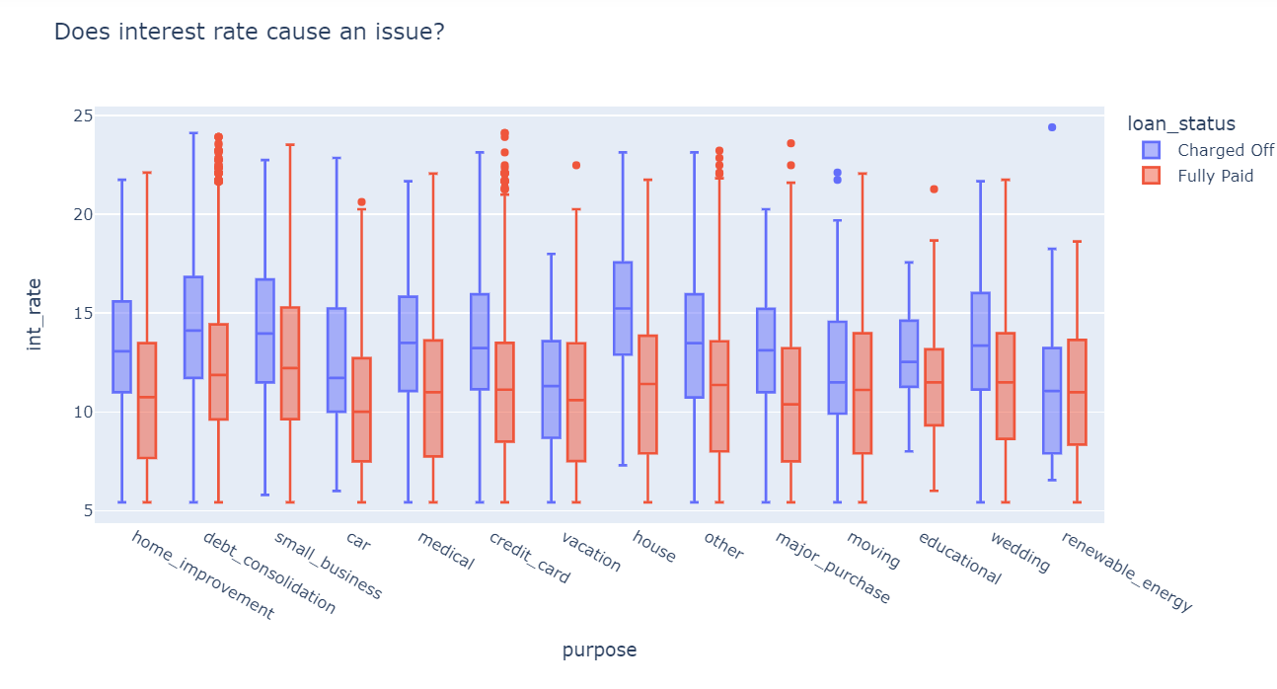
Defaulters in different values of purpose
People borrowing loan for small businesses have highest risk of not repaying their loan on time.
From the above box plots we can observe that applicants of loan for "small businesses" with "charged off"loan status have highest interest rate on loans. Also there a pattern that can be observed that the rate of interest is higher for defaulters

Slide 7
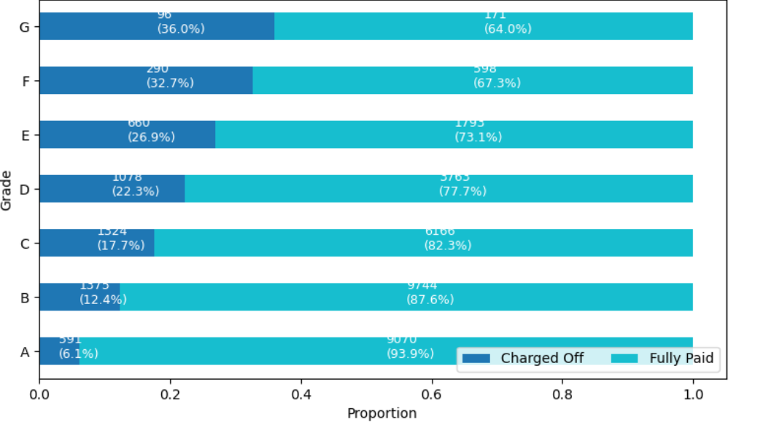
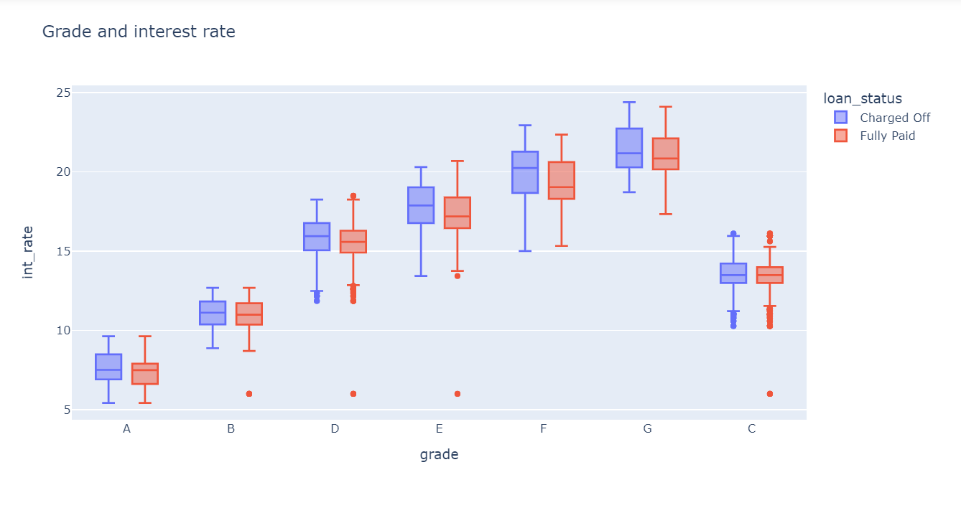
Defaulters according to grades
From the above graph we can observe that rate of defaulting is increasing moving from A to B
Interest rate if very high for grades E F and G which may contribute to non-repayment of loan

Slide 8
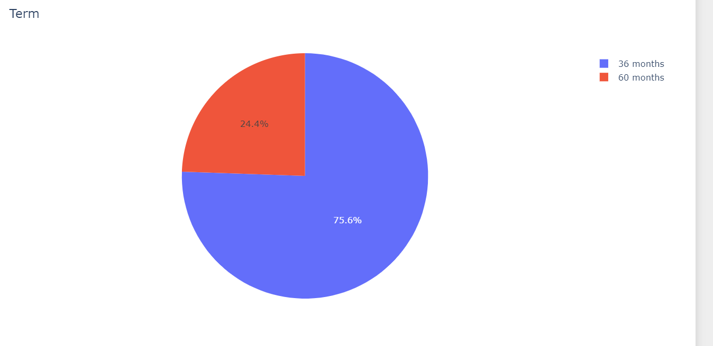
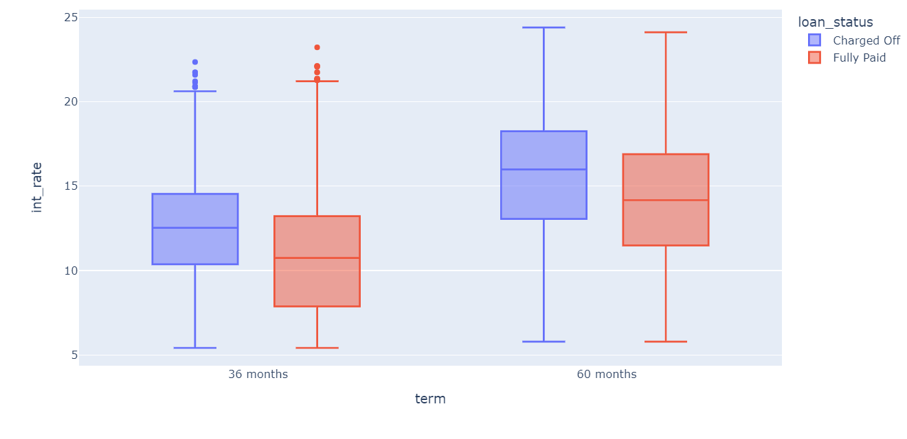
Term on the loan
Most loans lended by the company have a term of 36 months or 3 years i.e the loan borrower has 3 years from the issue date to pay back to the company.
Interest rate increases with term on loan.

Slide 9
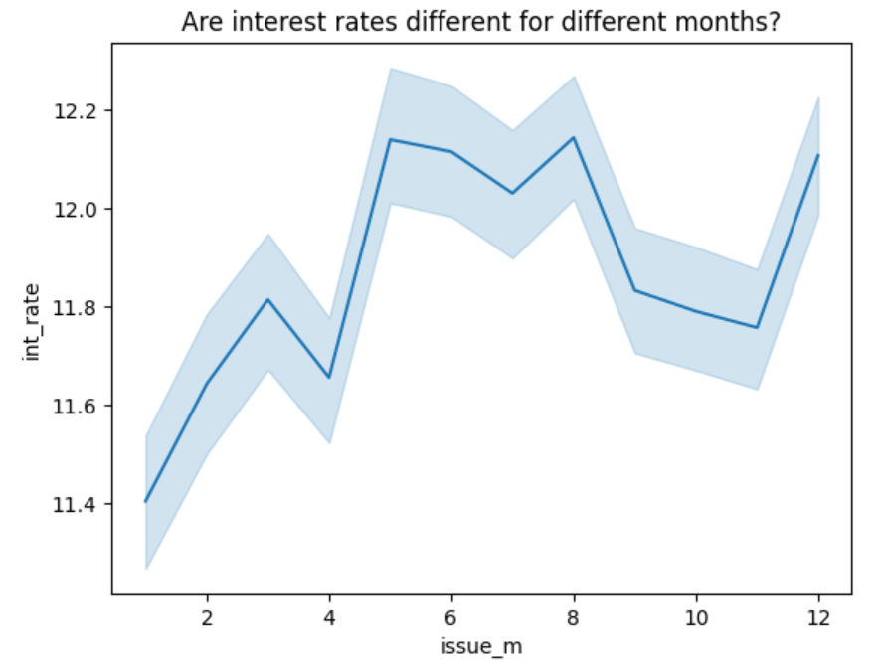
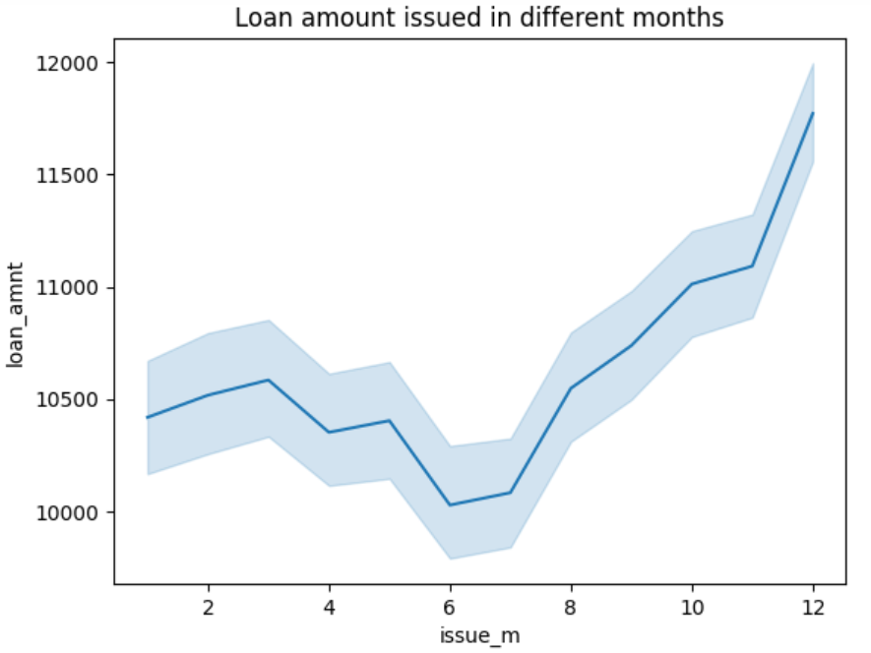
Interest rate and loan amount during the year 2022.
Interest rate were highest in the months of May, September and December. Also in the year 2022, customers applied for highest amount of loan in the month of december and lowest in June.

Slide 10
Conclusion
People borrowing money for small businesses have highest rate of default probably because of high risk of business not performing well along with factors like fall in the economy of the country etc. Hence Lenders should be careful before lending loans to them.
Loans grades as E,F and G have highest default risk because interest rates going up to 20%. Maybe the company should reduce the interest on these loans to reduce the risk of defaulting.
Interest rate is quite high for every purpose value
Interest rate also increases with term on loan. Loan with 36 months loan has higher interest rate than loan with 60 months. The company should reduce the interest rate on 60 months loans.

